Slide 1
API Testing
With Postman
Prepared by : Eslam ElRamikh

Slide 2
Main Topics
1
Introduction to API and HTTP Basics.
2
Status Codes , their types and uses.
3
API Documentation
4
API Testing with Postman

Slide 3


Introduction
API Definition
API Types
HTTP Basics
Notes:
https://pixabay.com/photos/architecture-building-amsterdam-1448221/

Slide 4
Introduction to API
Definition
Application Programming Interface (API) is a software interface that allows two applications to interact with each other without any user intervention. API is a collection of software functions and procedures. In simple terms, API means a software code that can be accessed or executed. API is defined as a code that helps two different software’s to communicate and exchange data with each other.

Slide 5
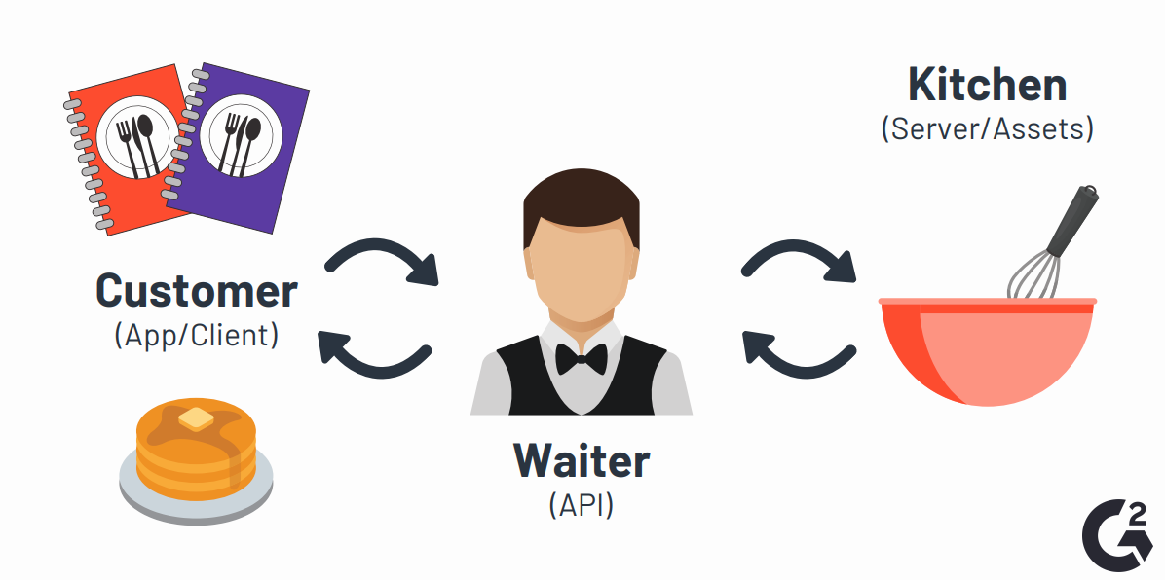
Introduction to API
Definition
The Restaurant Analogy

Slide 6
Introduction to API
Types of APIs
SOAP API
1-Protocol
2-Usually transports data in XML format
3-Uses higher bandwidth
REST API
1-Architecturual Style
2-Usually Transports data in JSON forma
3-Uses Less Bandwidth

Slide 7
Introduction to API
HTTP Basics
HTTP Methods
1-GET
A GET request is used to retrieve data.
This request does not perform any update on the server. The GET method is used to do the following:
-Retrieve details of a resource.
-Search resources based on given query parameters.

Slide 8
Introduction to API
HTTP Basics
HTTP Methods
2-POST
A POST request is used to create a new resource.
About the Location Header
If the POST request results in the creation of a resource, the response includes a Location header with the address of the new resource.

Slide 9
Introduction to API
HTTP Basics
HTTP Methods
3-PUT
A PUT request is used to replace a resource.
Use the PUT method to update a resource (available at the given URI) with another resource.
Following are some points to consider when using the PUT method in the request body:
♣ If a parameter is not provided, the existing database value for that parameter will be replaced by blank or default.
♣ If a parameter is set to blank, the database value will be updated with blank.
♣ If a parameter is set to a valid value, the database value will be updated with the given value.

Slide 10
Introduction to API
HTTP Basics
HTTP Methods
4-PATCH
A PATCH request is used for partial updates to an existing resource. In this case, all the values that are part of the request are updated.
Following are some points to consider when using the PATCH method in the request body:
♣ If a parameter is not provided, the existing database value for that parameter will remain unchanged.
♣ If a parameter is set to blank, the database value will be updated with blank.
♣ If a parameter is set to a valid value, the database value will be updated with the given value.

Slide 11
Introduction to API
HTTP Basics
HTTP Methods
5-DELETE
A DELETE request is used to remove a resource.
You can use the DELETE method to delete an entity or to remove one or more associations from an entity.

Slide 12

Status Codes
1xx Status Codes 2xx Status Codes
3xx Status Codes 4xx Status Codes
5xx Status Codes

Slide 13
Status Codes
What are Status Codes?
HTTP status codes are three-digit responses from the server to the browser-side request with the first digit defining the class of the response.
♣ 1xx: Informational: It means the request has been received and the process is continuing.
♣ 2xx: Success: It means the action was successfully received, understood, and accepted.
♣ 3xx: Redirection: It means further action must be taken in order to complete the request.
♣ 4xx: Client Error: It means the request contains incorrect syntax or cannot be fulfilled.
♣ 5xx: Server Error: It means the server failed to fulfill an apparently valid request.

Slide 14
Status Codes
1XX : Information
100 Continue: Only a part of the request has been received by the server, but as long as it has not been rejected, the client should continue with the request.
101 Switching Protocols: The server switches protocol.

Slide 15
Status Codes
2XX : Successful
200 OK
201 Created
202 Accepted
203 Non-authoritative Information
204 No Content
205 Reset Content
206 Partial Content

Slide 16
Status Codes
3XX : Redirection
300 - Multiple Choices
301 Moved Permanently
302 - Found (Moved Temporarily)
303 See Other
304 Not modified
307 Temporary Redirect: This has the same semantic as the HTTP 302 "Found" Status Code, with the exception that the user agent must not change the HTTP method used.
308 Permanent Redirect: This has the same semantics as the HTTP 301 "Moved Permanently" Status Code, with the exception that the user agent must not change the HTTP method used.

Slide 17
Status Codes
4XX : Client Error
400 Bad Request: Incorrect Syntax was made By Client
401 Unauthorized: The request was not sent with the proper authentication credentials
403 Forbidden : indicates that the server understands the request but refuses to authorize it
404 Not Found: the server could not find the requested website. In other words, your web browser can connect with the server, but the specific page you're trying to access can't be reached.

Slide 18
Status Codes
5XX : Server Error
500 Internal Server Error: The server encountered an unexpected condition which prevented it from fulfilling the request.
503 Service Unavailable: This error occurs when the server is unable to handle requests due to a temporary overload or due to the server being temporarily closed for maintenance.

Slide 19
API Documentation
Notes:
https://pixabay.com/photos/architecture-building-amsterdam-1448221/

Slide 20
API Documentation
Definition
API documentation is technical content that documents the API. It includes instructions on how to effectively use and integrate the API. It also provides updates on the API's lifecycle such as new versions or retirement.

Slide 21
API Documentation
Contents
-A quick start guide
-Authentication information
-Explanations for every API call (request)
-Examples of every request and return with a response description, error messages, etc

Slide 22
API Testing
With Postman
Notes:
https://pixabay.com/photos/architecture-building-amsterdam-1448221/

Slide 23

API Testing with Postman
Postman: is an application used for API testing. It is an HTTP client that tests HTTP requests, utilizing a graphical user interface, through which we obtain different types of responses that need to be subsequently validated

Slide 24
Why Postman ?
Free.
Easy to use.
APIs Support.
Extensible.
Integration.
Community and Support.

Slide 25
Thanks for listening

